Slide 1
Performance Monitor
Names

Slide 2
Introduction
Our aims:
Stable program
Efficient interface
Multiple users
Security management
Notes:
Tulga

Slide 3
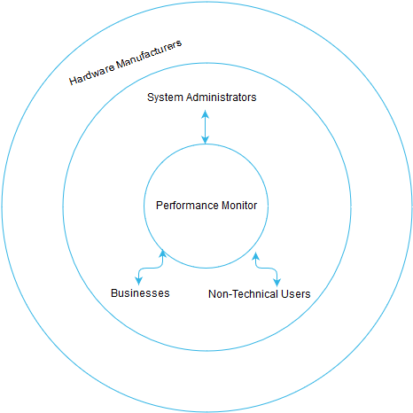
The Scope
Represents who the program affects directly and indirectly.
Directly – users
Indirectly – hardware manufacturers
Notes:
Abubaker

Slide 4
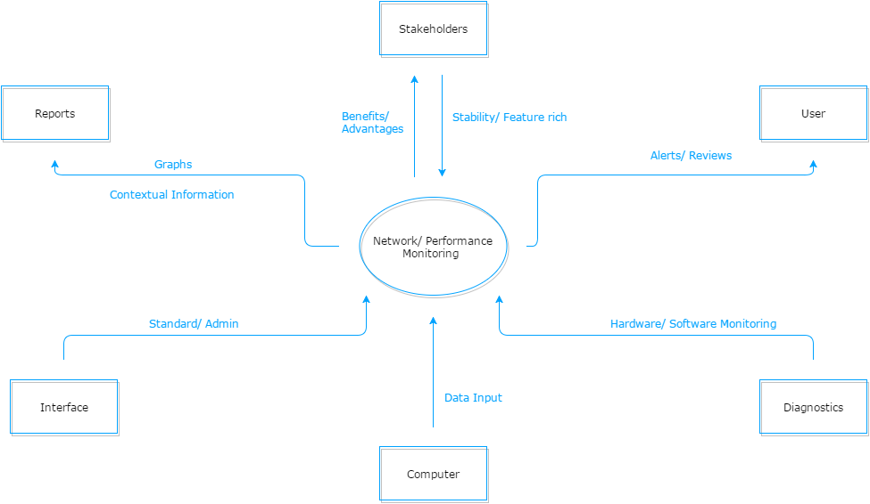
Context
How our program will interact with it’s environment.
Arrows going towards centre – environment to program
Arrows going away from centre – program outputting specific requirements
Notes:
Abubaker

Slide 5
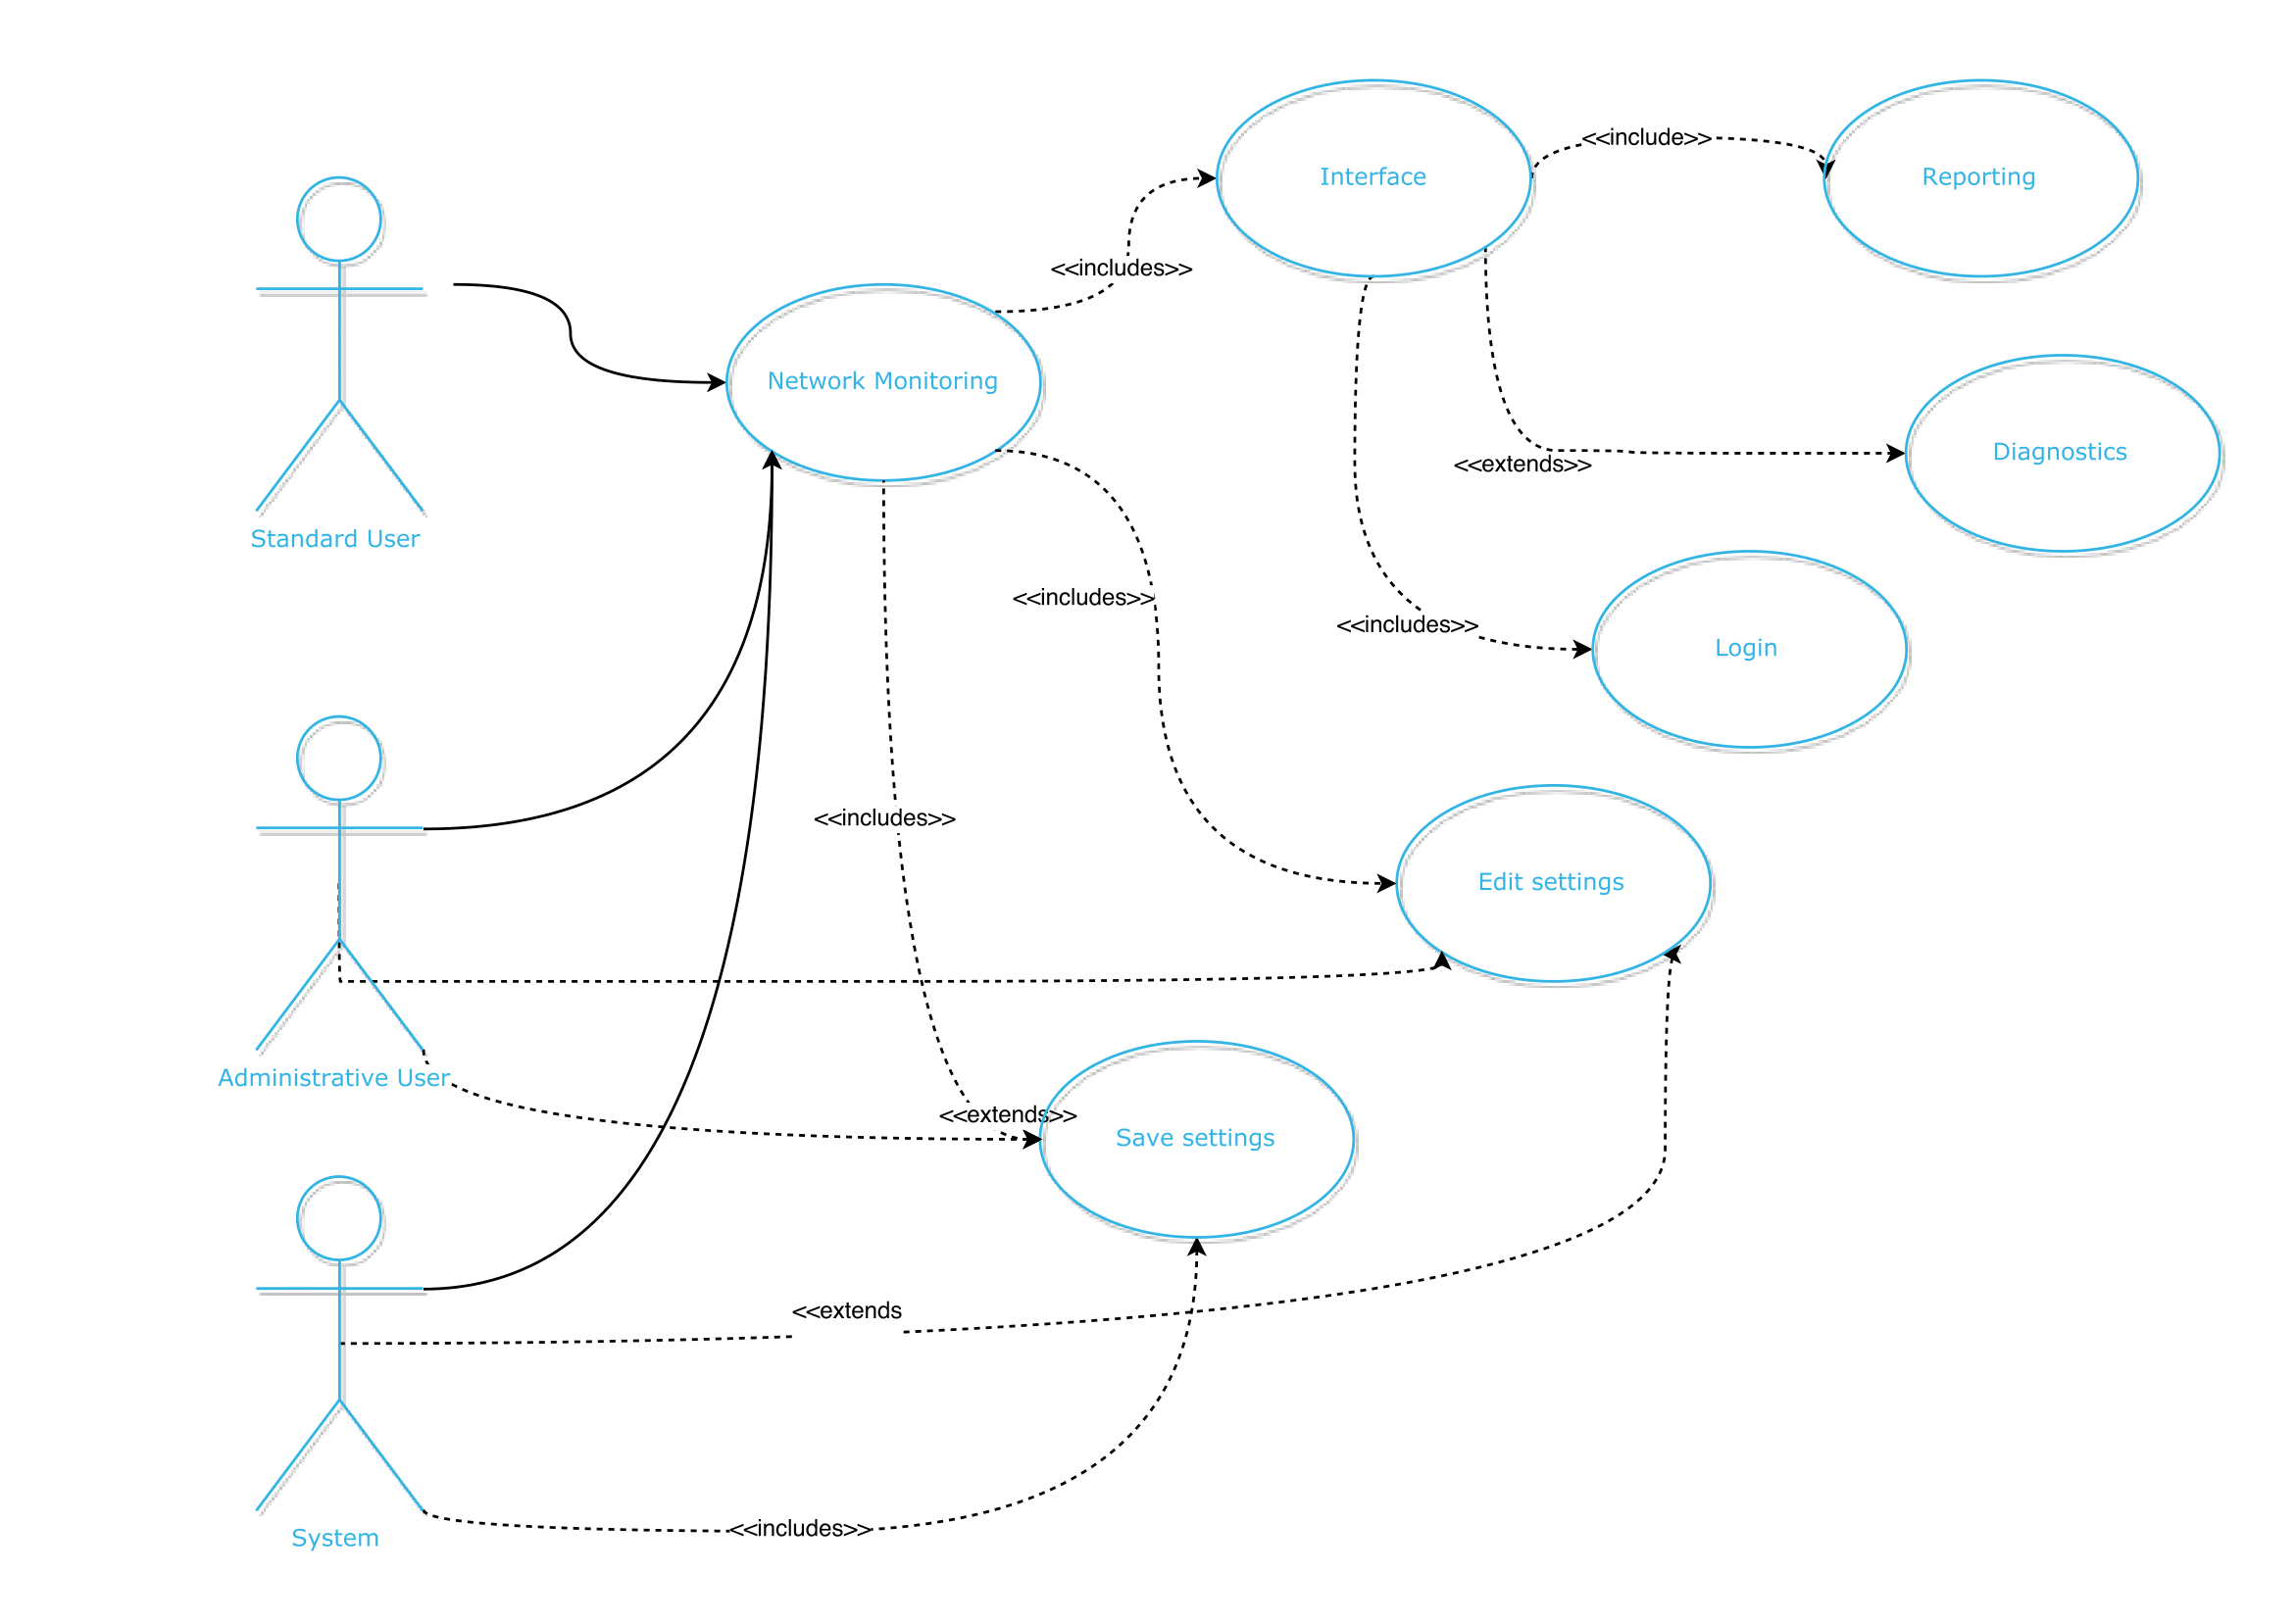
Use Case
How the actors and the system interact with one another
Admin/System can perform all functions including edit/save settings
User is limited to core functions connected to Network Monitoring
Notes:
Tulga

Slide 6
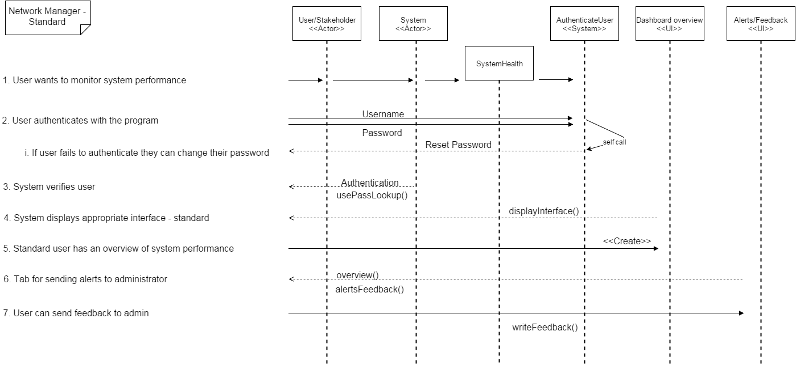
Sequence Diagram User
Standard user objects and their interactions
Objects message other objects to perform functions
Notes:
Harsh

Slide 7
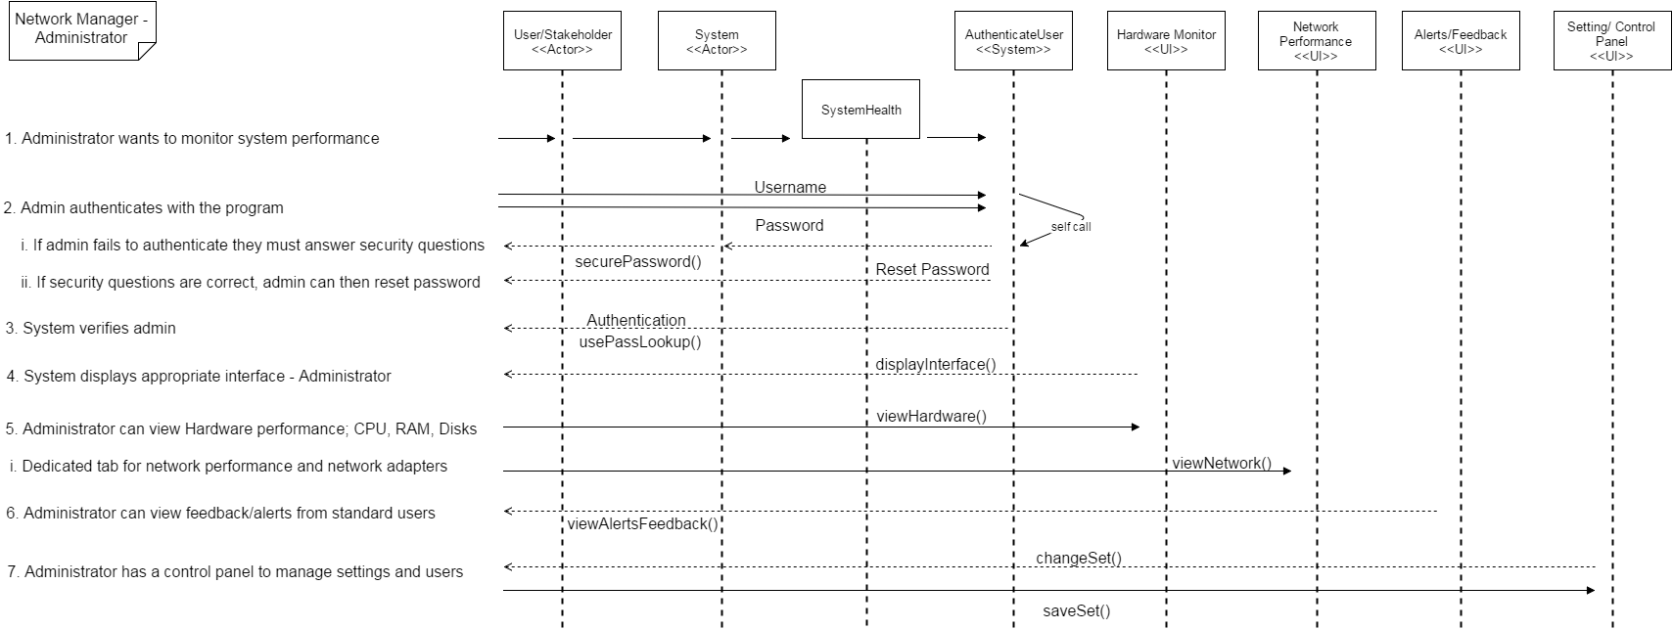
Sequence Diagram Administrator
Administrator user objects and their interactions
More class/objects as they have more control
Notes:
Harsh

Slide 8
Architecture
Getter and Setters
Agent and GUI split
OS-Specific agent implementation
Database abstraction
Helper classes
Tabular GUI
Minimal but contextual
Notes:
Martin

Slide 9
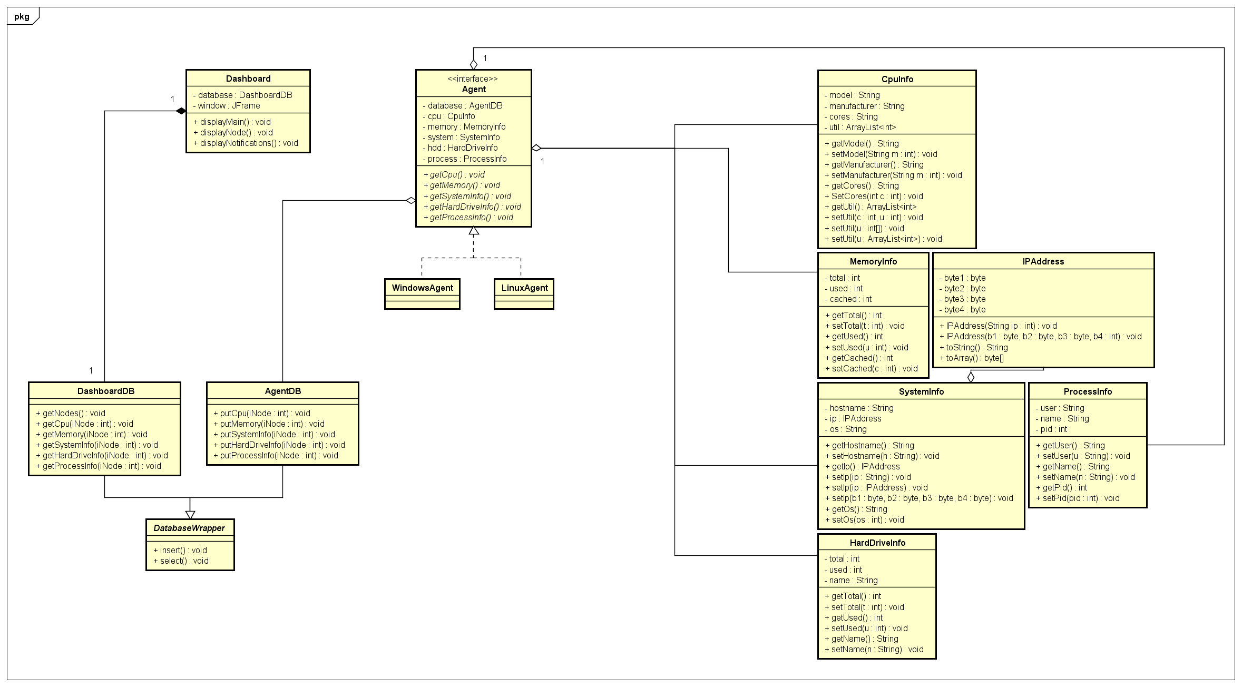
Class Diagram
Notes:
Martin

Slide 10
Design - Standard
Notes:
Niral

Slide 11
Design - Administrator
Notes:
Niral

Slide 12
Conclusion
We have proved
Efficient
Easily managed
Secure
Accurate statistics
To lighten your mood:
I was going to tell you guys a joke about UDP, but you might not get it!
Notes:
Romina

